Slide 1
jQuery
IN712 Web 3

Slide 2
Background
As always happens with powerful and complex languages, people have developed libraries –collections of prewritten classes and methods – for JavaScript
Some of these libraries are extremely useful, and eliminate or reduce some of the more cumbersome aspects of JavaScript coding
Since JavaScript itself is not compiled, neither are its libraries. That is, they are also simply text files with a .js extension. To use a JavaScript library, all you have to do is get a copy of the necessary .js file(s) drop it (them) into your project folder and link it (them) up in the header of your html
There are now 100s of 3rd party JavaScript libraries available -- some niche, some general; some more useful than others
But arguably the most important, and certainly the most widely used, is jQuery

Slide 3
jQuery
jQuery doesn’t actually add much new functionality to JavaScript (like, for example, a graphing library like Raphael.js does), but it greatly simplifies client-side coding by providing neater alternatives for some core processing tasks
Cross-browser protection
jQuery functions have been written to work correctly on all browsers, so you don’t have to worry about it
Efficient node selection
alternative syntax for selecting nodes and groups of nodes from the DOM
Implied iteration
jQuery selections return a set of nodes (technically a jQuery object) and jQuery operations act on *all those nodes at once* (making jQuery set-based like SQL)
This eliminates the need for explicit for-looping over everything
Talk over the network to fetch new content without having to refresh the entire HTML
Straightforward Ajax implementation

Slide 4
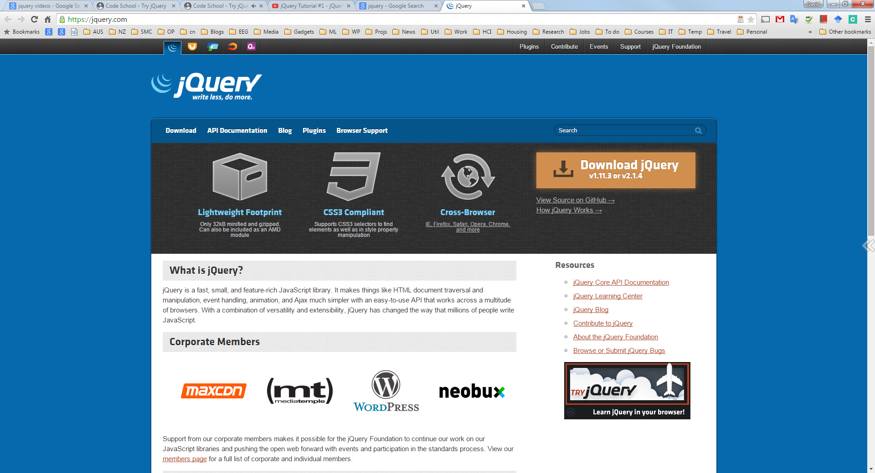
jQuery
http://jquery.com/

Slide 5

Getting jQuery
www.jQuery.com
You can here get either the development version (unminified) or the production version (minified).
“Minification” is just taking out the white spaces To make the file size is small as possible. Not much use if you want to look at it. But a reasonable trade‐off in a production environment.
Remember “links before scripts”, so stylesheets then <script> tags.
Also, you should place the jQuery file before your own file if you want to use the jQuery load event in your own code (discussion in a minute).

Slide 6
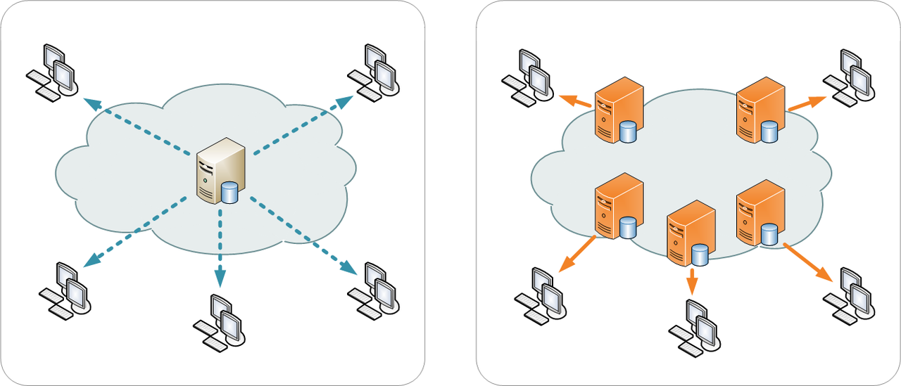
Content delivery network
<script src="https://ajax.googleapis.com/ajax/libs/jquery/2.1.4/jquery.min.js"></script>

Slide 7
jQuery Selection Syntax
At the heart of jQuery is the jQuery() function
But in most cases, you’ll use an alias: the dollar function, $().
The selector is CSS-style (uses the DOM) and indicates what element(s) the statement is to be applied to
The functions are jQuery library methods. Each takes specific arguments and returns specific output
Functions are chained together and pass their return value down the line
Most jQuery functions return the object they received, so you are effectively performing multiple actions on the same entity.
This programming paradigm (which is quite different from the C-family) is called functional programming.
actually a old technique that is undergoing a resurgence at the moment.

Slide 8
Selecting Elements
Find elements in the DOM with CSS selectors
var elements = $("a");
jQuery also lets you use multiple selectors in one function call.
var anotherElement = $("a, #myDiv, .myCssClass, p > span");
you can use just about any valid CSS selector to retrieve your desired elements
The element variable contains now a jQuery object which is an array representing all <a/> elements in the page
Any method you call on this particular jQuery object will perform the same operation on all elements in the array.
elements.attr("target", "_blank");
Because jQuery objects are an array, you can use the length property to find out how many elements were selected with a CSS query
var length = elements.length;

Slide 9
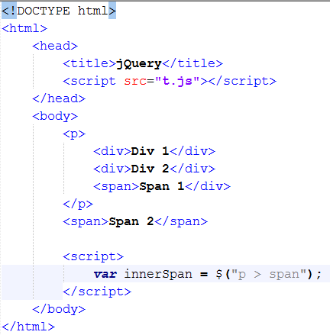
Selecting Elements

Slide 10
jQuery Selectors
jQuery Attribute Selectors
$("[href]") select all elements with an href attribute.
$("[href='#']") select all elements with an href value equal to "#".
$("[href!='#']") select all elements with an href attribute NOT equal to "#".
$("[href$='.jpg']") select all elements with an href attribute that ends with ".jpg".

Slide 11
More Examples
Syntax Description
$(this) Current HTML element
$("p") All <p> elements
$("p.intro") All <p> elements with class="intro"
$("p#intro") All <p> elements with id="intro"
$("p#intro:first") The first <p> element with id="intro"
$(".intro") All elements with class="intro"
$("#intro") The first element with id="intro"
$("ul li:first") The first <li> element of the first <ul>
$("ul li:first-child") The first <li> element of every <ul>
$(“ul li:nth-child(3)” The third <li> element of every <ul>
$("[href$='.jpg']") All elements with an href attribute that ends with ".jpg"
$("div#intro .head") All elements with class="head" inside a <div> element with id="intro“
$(‘#animals > li’) All <li> that are direct children of the element with id animals
$(‘#animals li’) All <li> that are descendants (at any level) of the element with id animals
$(‘#cities li:not(.red)’) All <li> that are descendants of the element with id cities and which are not class red
$(‘tr:even’) All even numbered tr elements (i.e. rows 0, 2, 4, etc. of any table).
$('li:contains("Donkey")') Any <li> that contains the string Donkey. Note the double and single quotes.

Slide 12

Changing style
Changing an element’s style requires you to either modify individual CSS properties or manipulate its CSS classes.
$("#myDiv").attr("style", "color:red;");
$("#myDiv").css("color", "red");
The property names you pass to the css() method can be in either style sheet format or in script format.
That means if you want to change an element’s background color, you can pass background‐color or backgroundColor to the method

Slide 13

Changing style
Often you might need to change more than one CSS property.
You can easily accomplish this by calling css() multiple times like this:
Or the more elegant alternative using an object containing CSS properties in their values.

Slide 14
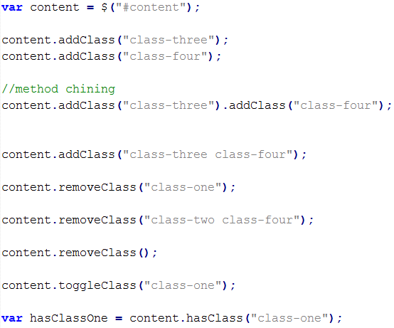
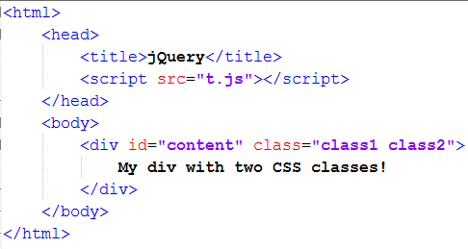
Adding and Removing CSS Classes
if you want to change an element’s style, it’s better to change the element’s CSS class instead of individual style properties
//method chaining

Slide 15
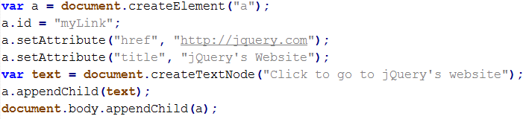
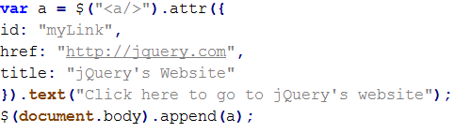
Creating and appending elements

Slide 16
Removing Elements
The only thing you need is the element that you want to remove. Simply call jQuery’s remove() method, and it removes the element.
You can also completely empty, or remove all children of, an element with the aptly named empty() method
If you wanted to remove every element within the <body/>, you could use the following code

Slide 17
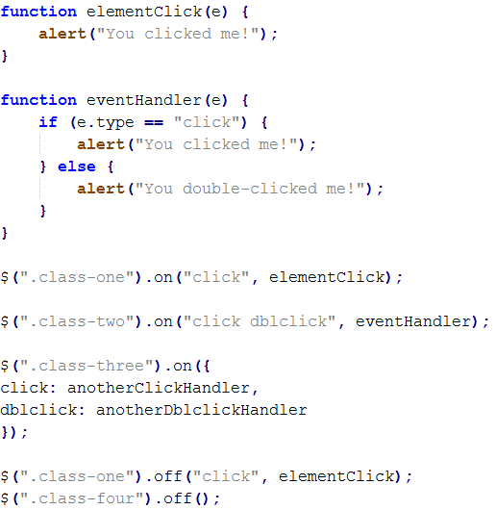
Handling events
All jQuery objects expose a method called on() that you use to register event listeners for one or more events on the selected elements.

Slide 18
Sample Events
$(document).ready(function)
Binds a function to the ready event of a document (when the document is finished loading). This is similar to window.onload()
$(selector).focus(function)
Triggers, or binds a function to the focus event of selected elements
$(selector).mouseover(function)
Triggers, or binds a function to the mouseover event of selected elements.

Slide 19
Initialising with jQuery
Similar to window.onload, but somewhat safer
We need to make sure the DOM has finished loading
Before we can safely interact with anything on the page
Note that document not does have quotes around it – it is not a CSS selector, it is an object reference.
$(document).ready(function()
{
/* all your code here */
});

Slide 20
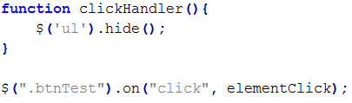
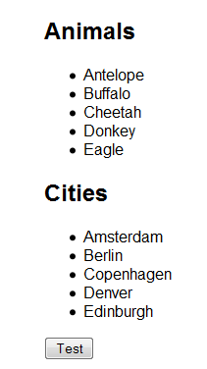
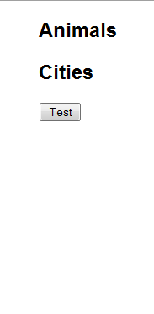
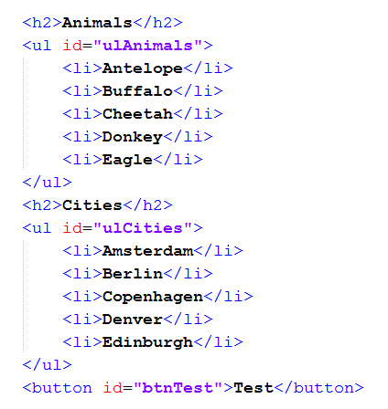
Example

Slide 21
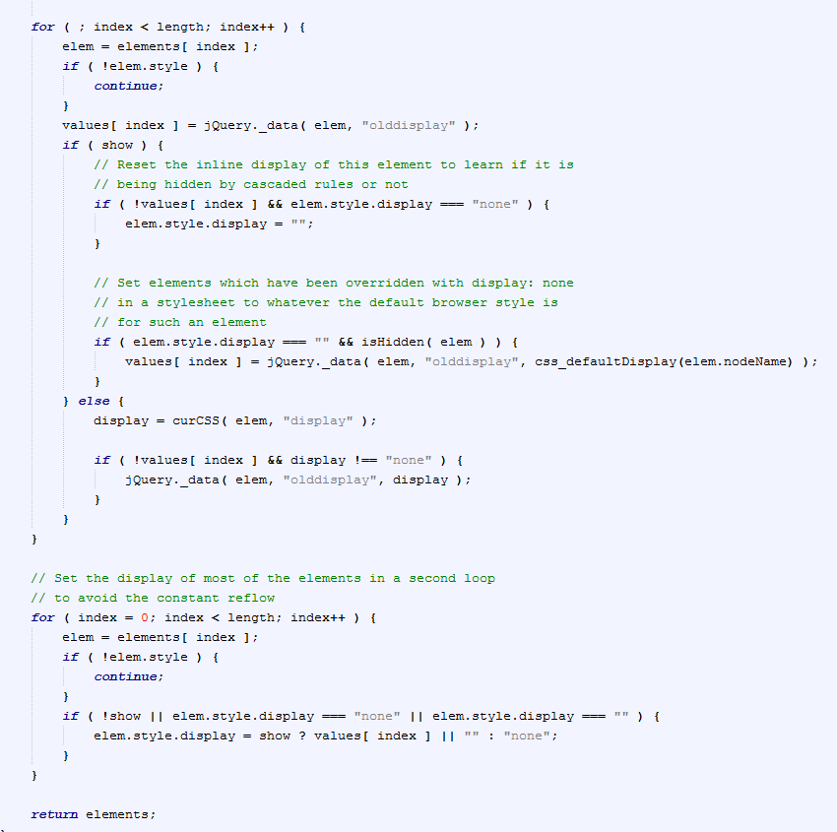
Jquery behind the scenes
It’s easy to look at the jQuery code that is actually executed when you say “hide”. Just open up the text file and look at it.
Here is a portion of that code (There’s actually quite a bit of it because hide is itself an extension of this function, which is a general show/hide. Take a look if you’re keen).
You can see that, in addition to the iteration, this code contains a lot of checks and corrections to ensure robustness.
If you wanted to write a generalise hiding function, you’d need to do that to.
The appeal of using jQuery is that you just say ‘hide()’

Slide 22
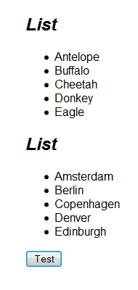

Modifying Content
Modifying html

Slide 23
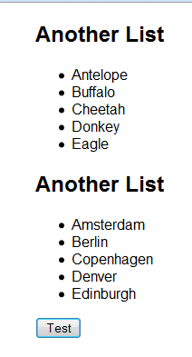

Modifying Content
Text

Slide 24

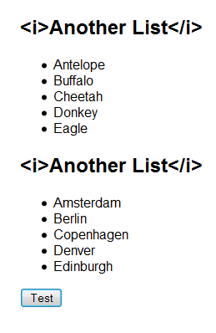
Modifying Content

Slide 25
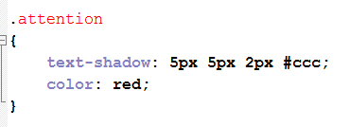
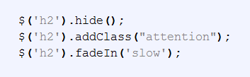

Chaining

Slide 26

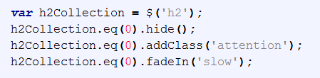
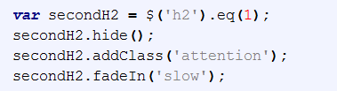
jQuery Objects

Slide 27
Filtering
A predicate is a condition (i.e. an expression that evaluates to true or false)
In the simplest case, a CSS selector is a predicate: each element either is or is not described by the selector.

Slide 28
Filtering
$(‘selector’).filter(predicate)
var selectedLi = $(‘li’).filter(‘.attention’); //Here we select all <li> of class attention
Filtering can be much more complex, as the predicate can be any function that evaluates to a boolean

Slide 29
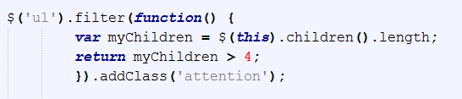
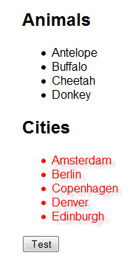
Filtering
$(‘selector’).filter(predicate()).f(args)….f(args)

Slide 30
Adding Elements to the DOM
Finally, you can dynamically add to the html based on user input, runtime conditions, whatever.
after()
before()
remove()
detach()
replaceWith()
prepend()
append()

Slide 31

Ajax with jQuery

Slide 32
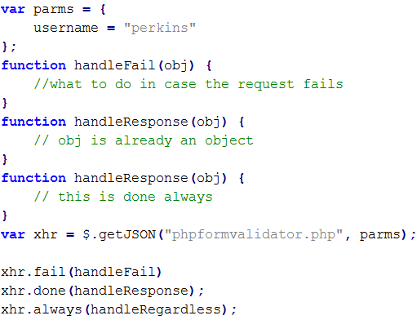
The jqXHR Object

